Slide 1
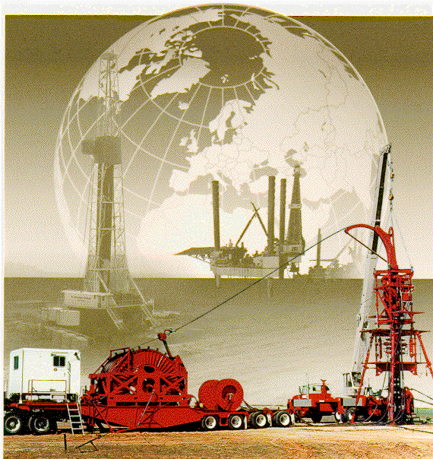
RU&RD Coiled Tubing
Units
GWDC well Testing Company
2010.12

Slide 2
Coiled Tubing Advantages
Overall Process and Cost Efficiency
Underbalanced Well Service
Work through existing wellhead & production equipment
No formation damage
Ability to Push / Pull in Deviated Hole
Performance - Speed In and Out of Hole
Reliable Tubing Management
Versatility in Rig-up, Application, and Conveyance

Slide 3
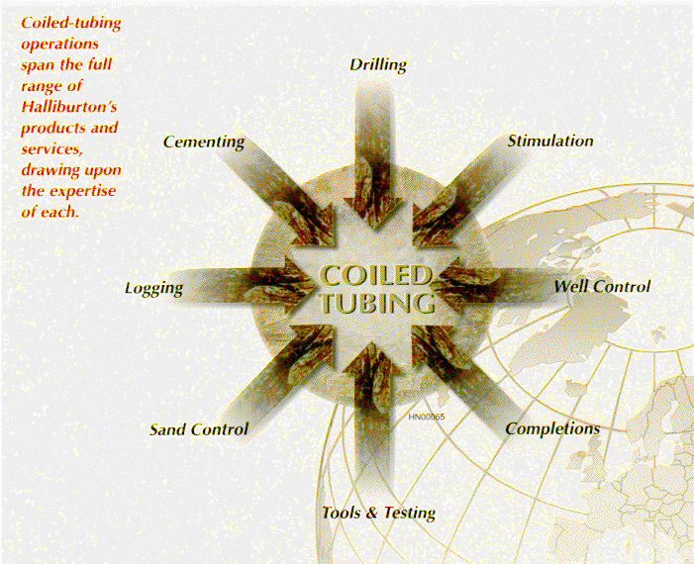
Coiled Tubing Solutions
Coiled tubing operations span the full range of our products and services, drawing upon the expertise of each.

Slide 4
Coiled Tubing Applications
Clean-outs - Foam, Fluid, Polymer, & Nitrified Fluids
High Pressure Coil Clean-outs - 10,000 psi and greater working pressures
Fracturing through Coiled Tubing
Cementing - Acidizing - Chemical Injection

Slide 5
Coiled Tubing Applications
Motor/ Wash Tool Operations - Plug removal, Solids removal - Scale Removal
Specialty Applications - Pipeline cleanouts,Inflatable Packers, Jet Pumps & Velocity Strings

Slide 6
RU&RD CTU Equipment
Preparation in Base
2. Preparation in wellsite
3. Operation in wellsite

Slide 7
Preparation in Base
(1) Personal Preparation
(2) Equipment Check
(3) Well Information

Slide 8
Preparation in wellsite
(1) CTU Main Truck Position
(2) BOP and Injector Position
(3) Hand Tools

Slide 9
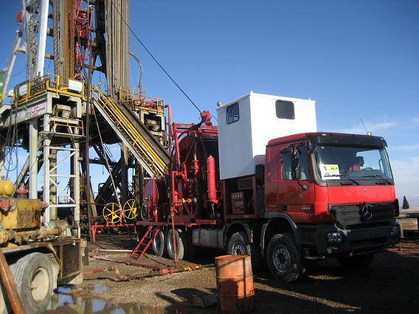
Preparation in wellsite
(1) CTU Main Truck Position
90°between truck axle and wellhead;
10-20m between truck deck and wellhead;
Parking on one side of the catwalk;
Cabin door against pump truck.

Slide 10
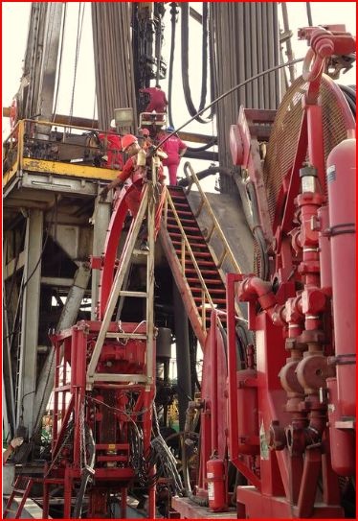
Preparation in wellsite
(2) BOP and Injector Position
Near to wellhead
Behead the main truck
On the flat ground
The direction of the gooseneck

Slide 11
Preparation in wellsite
(3) Hand Tools

Slide 12
Operation in wellsite
(1) Test and Connect BOP
(2) Connect and Test Injector
(3) Insert CT into injector
(4) Connect Injector to Wellhead
(5) Rig Down Injector from Wellhead
(6) Rig Down BOP From Wellhead

Slide 13
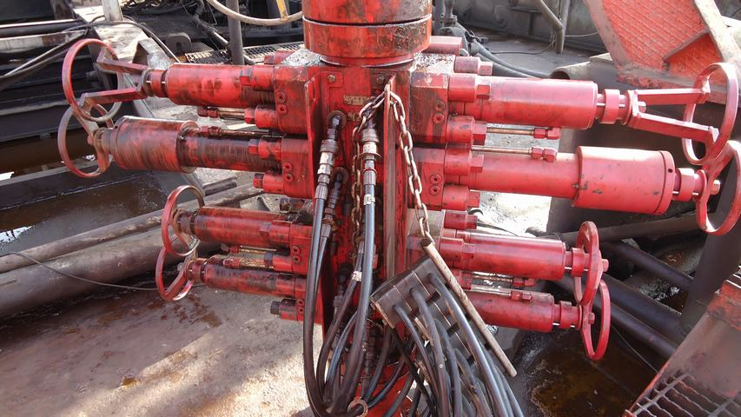
Operation in wellsite
(1) Test and Connect BOP

Slide 14
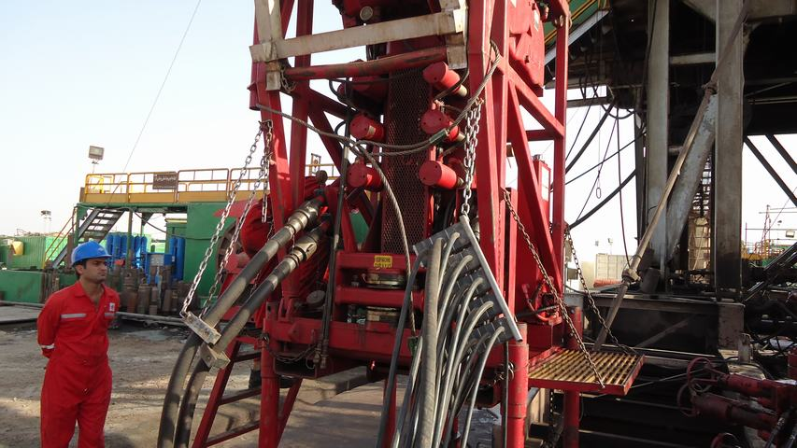
Operation in wellsite
(2) Connect and Test Injector

Slide 15
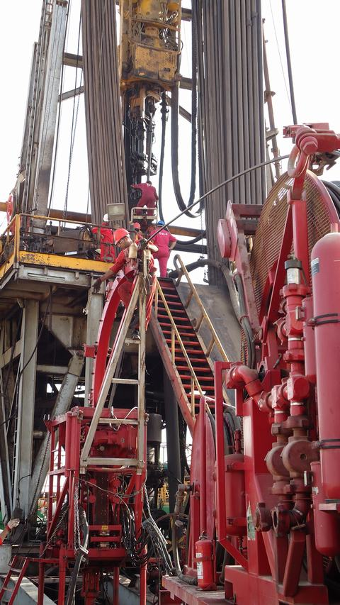
Operation in wellsite
(3) Insert CT into injector

Slide 16
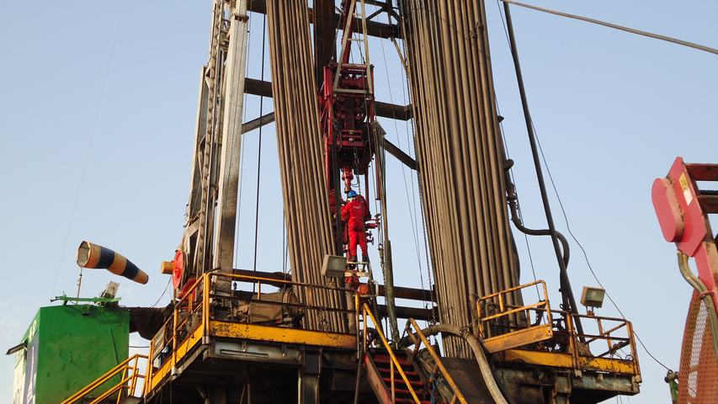
Operation in wellsite
(4) Connect Injector to Wellhead

Slide 17
Operation in wellsite
(5) Rig Down Injector from Wellhead
(6) Rig Down BOP From Wellhead

Slide 18
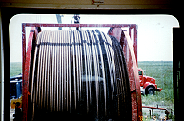
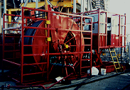


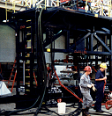


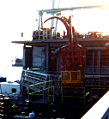
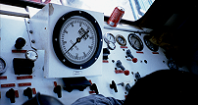
THE END
Coiled Tubing Applications

Slide 19
谢谢并恳请专家指正！

